Slide 1
Learning Objective
CFU
What will we learn today?
I will be able to solve simple linear equation.
CFU
How will you know that you are successful?
Success Criteria
At the end of the lesson, I will be able to:
Use the inverse operations to solve simple linear equation
Solve worded questions

Slide 2
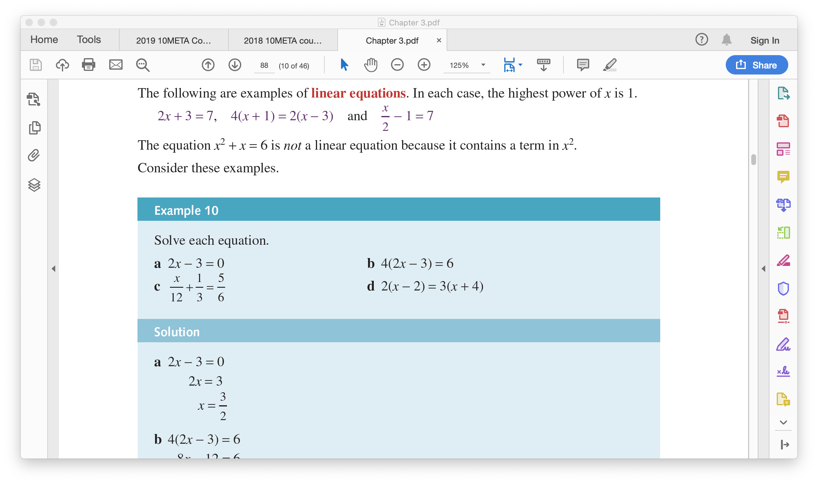
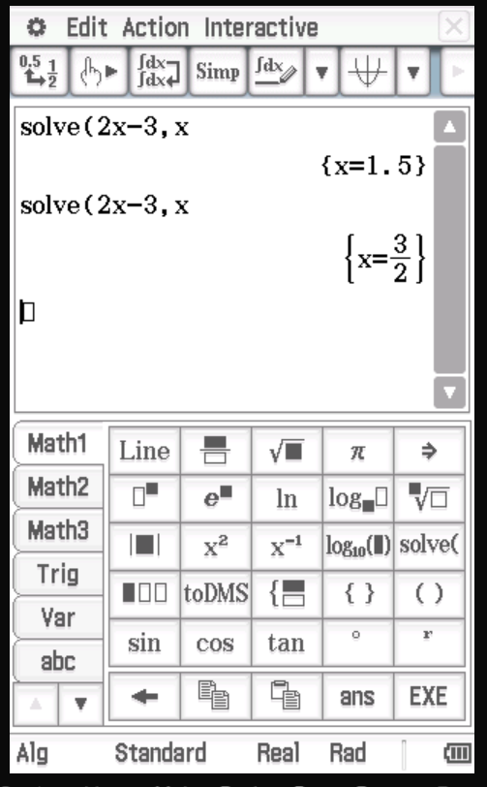
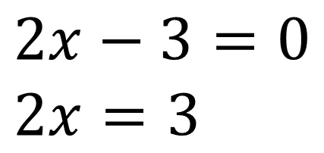
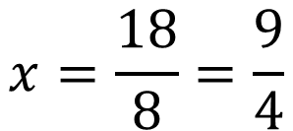

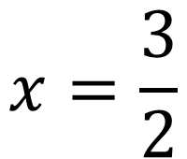
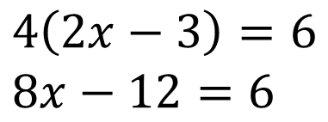
Guided Practice
$$2x−3=0 \\ 2x=3$$
$$4\left(2x−3\right)=6 \\ 8x−12=6$$
$$8x=18$$
$$x=\frac{3}{2}$$
$$x=\frac{18}{8}=\frac{9}{4}$$

Slide 3

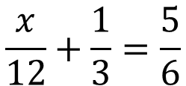



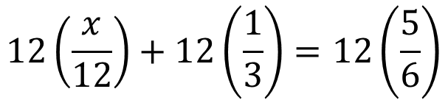

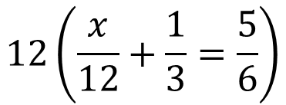

Guided Practice
$$\frac{x}{12}+\frac{1}{3}=\frac{5}{6}$$
$$2\left(x−2\right)=3(x+4)$$
Find the LCD:
12
$$2x−4=3x+12$$
Multiply 12 throughout
$$−12−4=3x−2x$$
$$12\left(\frac{x}{12}+\frac{1}{3}=\frac{5}{6}\right)$$
$$x=−16$$
$$12\left(\frac{x}{12}\right)+12\left(\frac{1}{3}\right)=12\left(\frac{5}{6}\right)$$
$$x+4=10$$
$$x=6$$

Slide 4
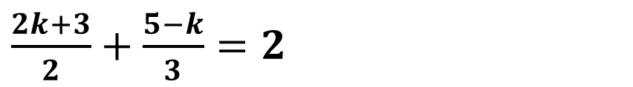
Guided Practice
Solve each of the following to find the unknown:
$\frac{2k+3}{2}+\frac{5−k}{3}=2$

Slide 5
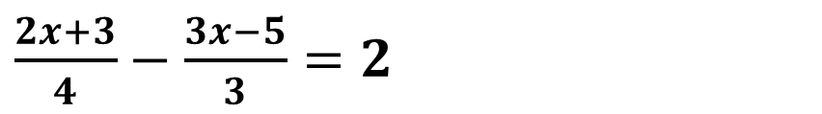
Guided Practice
Solve each of the following to find the unknown:
$\frac{2x+3}{4}−\frac{3x−5}{3}=2$

Slide 6


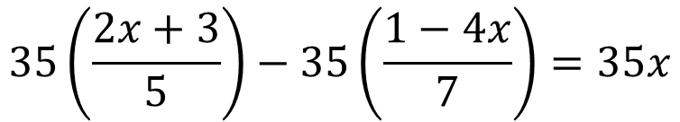


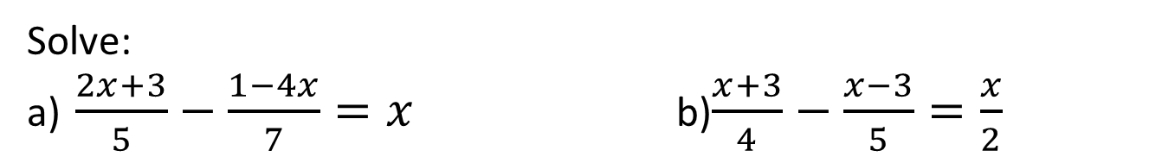




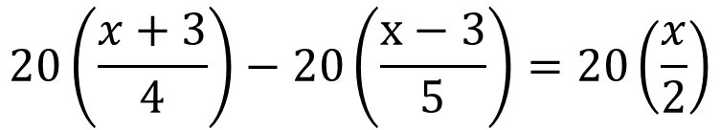

Guided Practice
Solve:
a) $\frac{2x+3}{5}−\frac{1−4x}{7}=x$ b)$\frac{x+3}{4}−\frac{x−3}{5}=\frac{x}{2}$
Find the LCD:
$20$
Find the LCD:
35
Multiply throughout
$$20\left(\frac{x+3}{4}\right)−20\left(\frac{x−3}{5}\right)=20\left(\frac{x}{2}\right)$$
Multiply 35 throughout
$$35\left(\frac{2x+3}{5}\right)−35\left(\frac{1−4x}{7}\right)=35x$$
$$5(x+3)−4\left(x−3\right)=10x$$
$$5x+15−4x+12=10x$$
$$7\left(2x+3\right)−5\left(1−4x\right)=35x$$
$$27=10x−x$$
$$14x+21−5+20x=35x$$
$$9x=27$$
$$34x+16=35x$$
$$x=3$$
$$x=16$$

Slide 7




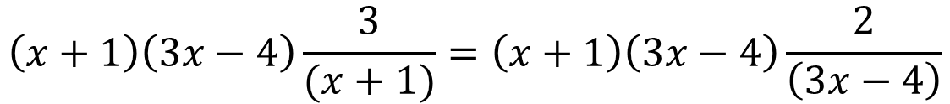
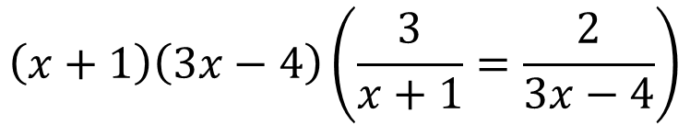

Guided Practice
Solve: $\frac{3}{(x+1)}=\frac{2}{(3x−4)}$
Find the LCD:
$(x+1)(3x−4)$
Multiply throughout
$$\left(x+1\right)\left(3x−4\right)\left(\frac{3}{x+1}=\frac{2}{3x−4}\right)$$
$$\left(x+1\right)\left(3x−4\right)\frac{3}{(x+1)}=\left(x+1\right)\left(3x−4\right)\frac{2}{\left(3x−4\right)}$$
$$\left(3x−4\right)3=\left(x+1\right)2$$
$$9x−12=2x+2$$
$$7x=14$$
$$x=2$$

Slide 8
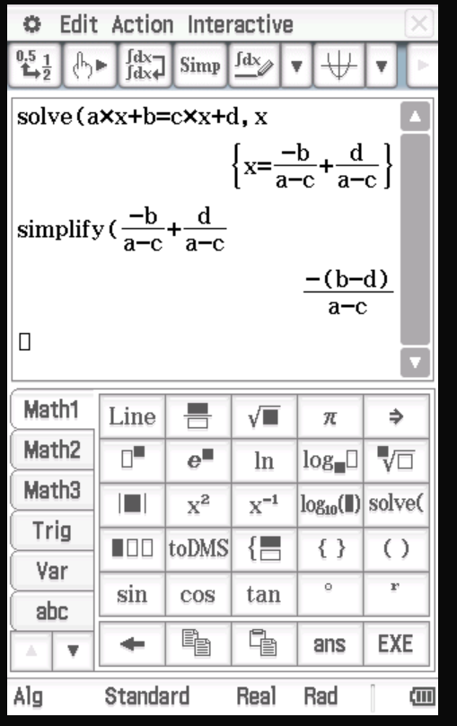
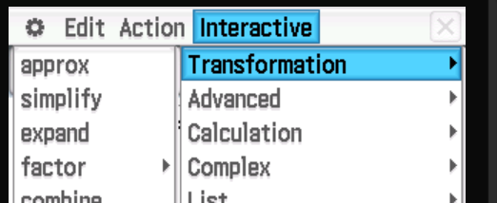

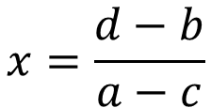

Guided Practice
Solve: $ax+b=cx+d$
$$ax−cx=d−b$$
$$x(a−c)=d−b$$
$$x=\frac{d−b}{a−c}$$

Slide 9
Activating Prior Knowledge
Solving problems using linear equations involves the following steps:
Step 1: Use a variable to define an unknown value
Step 2: Form an equation using the key words in the stated problem and the variable
Step 3: Solve the equation using inverse operations
Step 4: Answer the question in words
Step 5: Check your answers make sense and satisfy all conditions of the problem

Slide 10
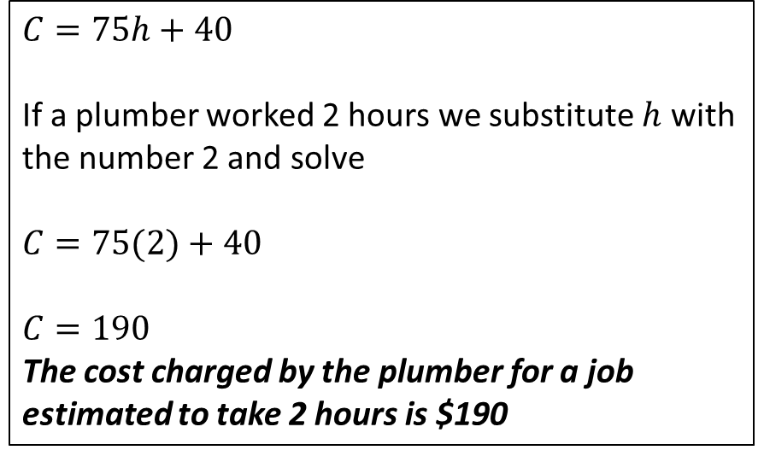
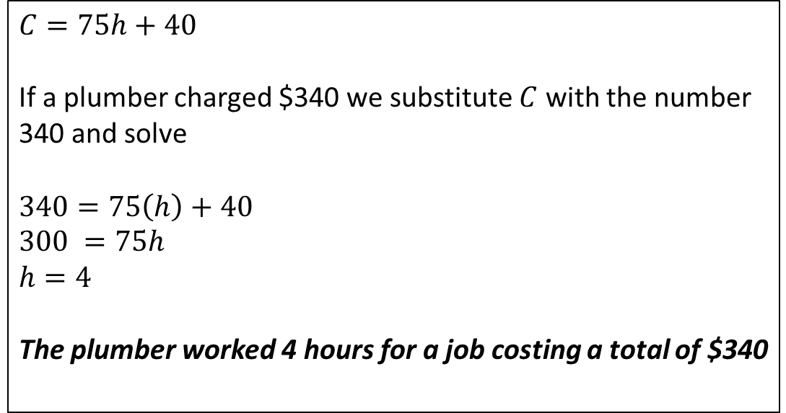
Skill Development
A plumber has a call out fee of $40, plus an hourly rate of $75. Write a formula to calculate the cost of any job. Calculate the cost of a job estimated to take 2 hours. Calculate the numbers of hours work if the plumber charged a total cost of $340
$40 is constant and $75 is the rate per number of hours worked.
Let the total cost = $C$ Number of hours worked = $h$
$$C=75h+40$$
If a plumber worked 2 hours we substitute $h$ with the number 2 and solve
$$C=75(2)+40$$
$$C=190$$
The cost charged by the plumber for a job estimated to take 2 hours is $190
$$C=75h+40$$
If a plumber charged $340 we substitute $C$ with the number 340 and solve
$$340=75\left(h\right)+40$$
$$300 =75h$$
$$h=4$$ The plumber worked 4 hours for a job costing a total of $340

Slide 11
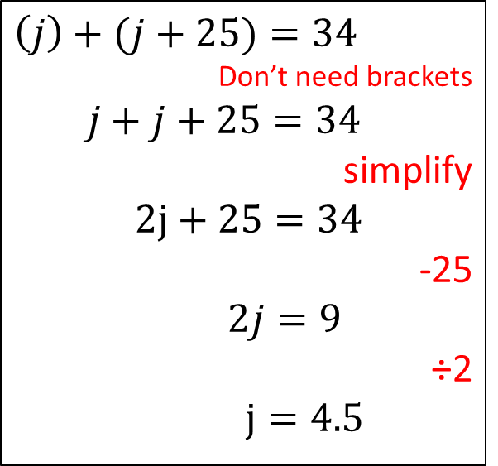
Skill Development
Jen’s mum is 25 years older than Jen. Together their ages add up to 34. How old is Jen?
Jen’s age = j Mother’s age = m?
Jen’s age = j
Her mother’s age in comparison = j +25
$$\left(j\right)+(j+25)=34$$
Don’t need brackets
$$j+j+25=34$$
simplify
$2j+25=34$
-25
$2j=9$
÷2
$j=4.5$
Jen’s age now is 4.5 years old and her mother’s age is 29.5 years old
Check the Solution
4.5 + 29.5 = 34

Slide 12


Guided Practice
Ken currently has $5 less money than Shane. If they have $139 combined, how much does each person currently have?
Ken= k Shane = s?
Ken’s current amount = k OR s - 5
Shane’s current amount = k + 5 OR s
$$\left(k\right)+(k+5)=139$$
Don’t need brackets
$$k+k+5=139$$
simplify
$2k+5=139$
-5
$2k=134$
÷2
$k=67$
$$\left(s\right)+(s−5)=139$$
Don’t need brackets
$$s+s−5=139$$
simplify
$2s−5=139$
+5
$2s=144$
÷2
$s=72$
Ken currently has $67 and Shane has $72
Check the Solution
67 + 72 = 139

Slide 13
Guided Practice
Find 3 consecutive even numbers whose sum is 126

Slide 14
Guided Practice
Sam divided his bag of lollies so that he and his friends, Nikki and Min could share them.
He gave himself twice as many as he gave Nikki, and Min received 3 times as many as Nikki.
If the bag contained 42 lollies, how many did each person receive?

Slide 15
Guided Practice
Ross is 20 years older than his niece Krystal. Krystal has worked out that in 5 years’ time, her uncle will be twice as old as she will be then. Find Krystal’s age.

Slide 16
Guided Practice
Ross is 20 years older than his niece Krystal. Krystal has worked out that in 5 years’ time, her uncle will be twice as old as she will be then. Find Krystal’s age.

Slide 17
Guided Practice
$48 is divided among three students A, B and C. If B receives three times as much as A, and C receives twice as much as A, how many does each receive?

Slide 18
Independent Practice
Complete Cambridge Ex 1A and 1B

